Slide 1

Chapter 4

Slide 2

x
i
y
i
Carry-in
c
i
Sum
s
i
Carry-out
c
i
+1
At the i^{th} stage:
Input:
c_{i} is the carry-in
Output:
s_{i} is the sum
c_{i+1} carry-out to (i+1)^{st}
state
0
0
0
0
0
0
0
1
1
0
0
1
0
1
0
0
1
1
0
1
1
0
0
1
0
1
0
1
0
1
1
1
0
0
1
1
1
1
1
1
s
i
=
x
i
y
i
c
i
+
x
i
y
i
c
i
+
x
i
y
i
c
i
+
x
i
y
i
c
i
=
x
i
⊕
y
i
⊕
c
i
c
=
y
i
c
i
+
x
i
c
i
+
x
i
y
i
i
+1
E
xample:
X
7
0
1
1
1
Carry-out
x
i
Carry-in
+
Y
=
+ 6
=
+
0
0
1
1
1
1
0
0
0
c
y
i
c
Z
13
1
1
0
1
i
+1
s
i
i
Legend for stage
i

Slide 3

Sum
Carry
y
i
c
i
x
i
y
s
x
i
c
i
i
c
i
i
+
1
c
i
x
x
i
y
i
y
i
i
c
i
+
1
Full adder
c
i
(F
A)
s
i
Full Adder (FA): Symbol for the complete circuit
for a single stage of addition.

Slide 4

Cascade n full adder (FA) blocks to form a n-bit adder.
Carries propagate or ripple through this cascade, n-bit ripple carry adder.
x
n
-
1
y
n
-
1
x
1
y
1
x
0
y
0
c
n
-
1
c
1
c
n
F
A
F
A
F
A
c
0
s
n
-
1
s
1
s
0
Most significant bit
Least significant bit
(MSB) position
(LSB) position
Carry-in c₀ into the LSB position provides a convenient way to
perform subtraction.

Slide 5
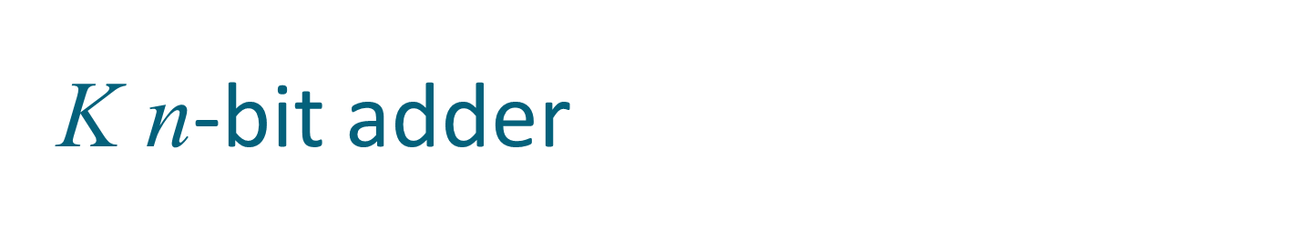
K n-bit numbers can be added by cascading k n-bit adders.
x
k
n
-
1
y
k
n
-
1
x
2
n
-
1
y
2
n
-
1
x
n
y
n
x
n
-
1
y
n
-
1
x
0
y
0
n
-
bit
n
-
bit
c
n
n
-
bit
c
k
n
adder
adder
adder
c
0
s
k
n
-
1
s
(
k
-
1
)
n
s
2
n
-
1
s
n
s
n
-
1
s
0
Each n-bit adder forms a block, so this is cascading of blocks.
Carries ripple or propagate through blocks, Blocked Ripple Carry Adder

Slide 6

Recall X – Y is equivalent to adding 2’s complement of Y to X.
2’s complement is equivalent to 1’s complement + 1.
X – Y = X + Y + 1
2’s complement of positive and negative numbers is computed similarly.
x
n
-
1
y
n
-
1
x
1
y
1
x
0
y
0
c
n
-
1
c
1
c
n
F
A
F
A
F
A
1
s
n
-
1
s
1
s
0
Most significant bit
Least significant bit
(MSB) position
(LSB) position

Slide 7

y
n
-
1
y
1
y
0
Add/Sub
control
x
n
-
1
x
1
x
0
c
n
-bit adder
n
c
0
s
n
-
1
s
1
s
0
Add/sub control = 0, addition.
Add/sub control = 1, subtraction.

Slide 8


Detecting overflows
Overflows can only occur when the sign of the two operands is the same.
Overflow occurs if the sign of the result is different from the sign of the operands.
Recall that the MSB represents the sign.
  x_{n-1}, y_{n-1}, s_{n-1} represent the sign of operand x, operand y and result s respectively.
Circuit to detect overflow can be implemented by the following logic expressions:

Slide 9

x₀
y₀
Consider 0th stage:
c₁ is available after 2 gate delays.
s₁ is available after 1 gate delay.
c₁
FA
c₀
s₀
Sum
Carry
y
i
c
i
x
i
y
s
x
i
c
i
i
c
i
i
+
1
c
i
x
y
i
i

Slide 10

Cascade of 4 Full Adders, or a 4-bit adder
x₀
y₀
x₀
y₀
x₀
y₀
x₀
y₀
FA
FA
FA
c₁
FA
c₀
c₄
c₃
c₂
s₃
s₂
s₁
s₀
s₀ available after 1 gate delays, c₁ available after 2 gate delays.
s₁ available after 3 gate delays, c₂ available after 4 gate delays.
s₂ available after 5 gate delays, c₃ available after 6 gate delays.
s₃ available after 7 gate delays, c₄ available after 8 gate delays.
For an n-bit adder, s_{n-1} is available after 2n-1 gate delays
c_{n} is available after 2n gate delays.

Slide 11
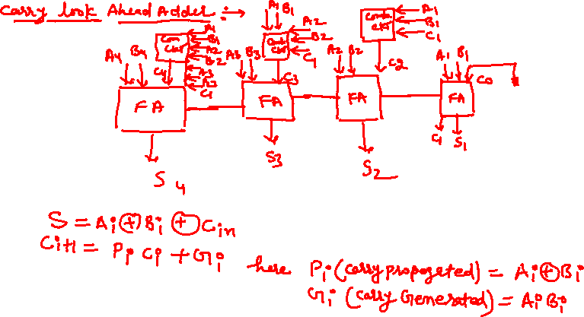

Slide 12


